Slide 1
ZaqZouqa Restaurant

Slide 2
Members of team
Name | ID
Moaz Ragab Abu ELmagd | 2100938
Esraa Atef Mohamed Mostafa | 2101016
Youssef Osama Mohamed | 2100988
Alaa atef Mohamed Mostafa | 2100482
Bassant Samy Sabry | 2100847

Slide 3
Contribution of team
Name | Contribution
Moaz Ragab Abu ELmagd | Bill , Order , Waiter , Card, GUI
Esraa Atef Mohamed Mostafa | Menu , Items, Gui, Exception Handling
Youssef Osama Mohamed | Uml , Person, Restaurant, InvalidNameException
Alaa atef Mohamed Mostafa | Stuff , Receptionist,Table Can Reserve ,GUI
Bassant Samy Sabry | Customer ,Manager, Cheff , Exception Handling

Slide 4
UML

Slide 5
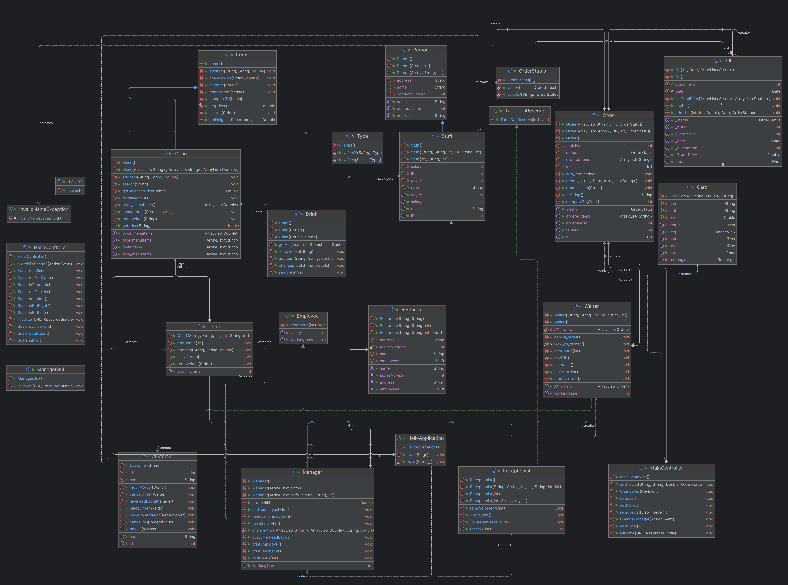
`

Slide 6
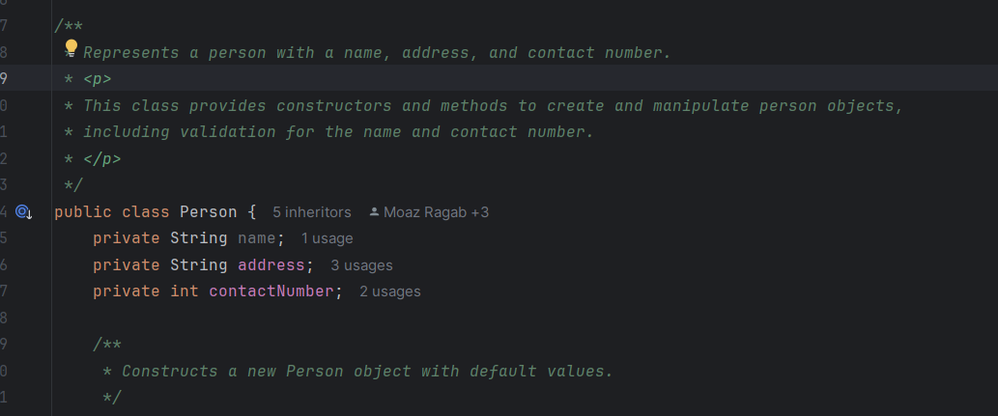
Encapsulation

Slide 7
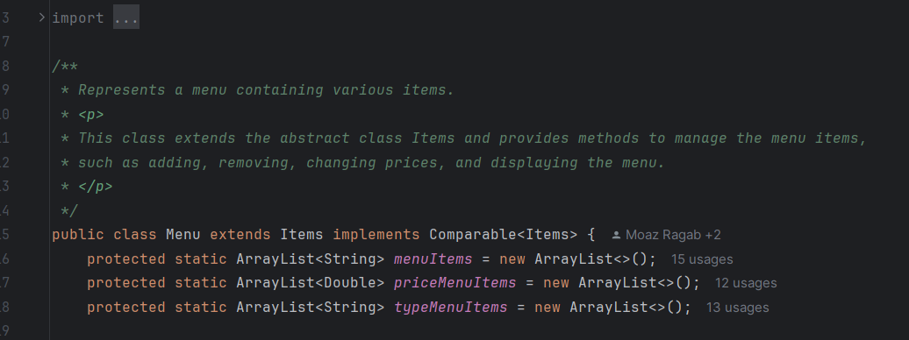
Encapsulation

Slide 8
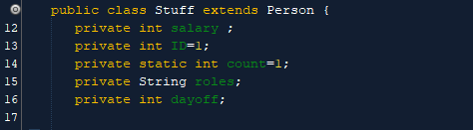
inheritance

Slide 9
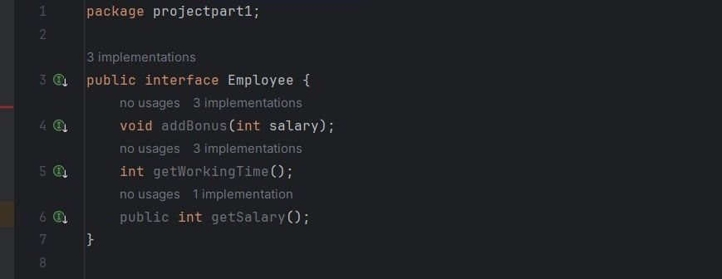
interface

Slide 10
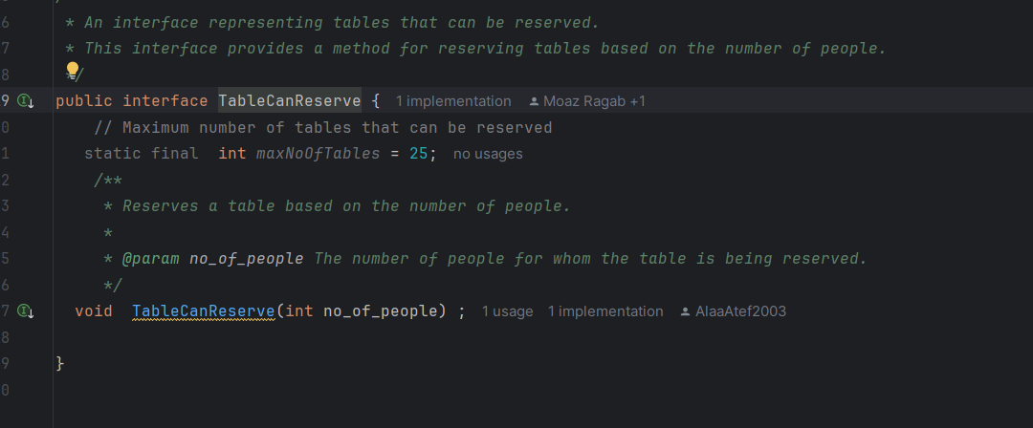
interface

Slide 11
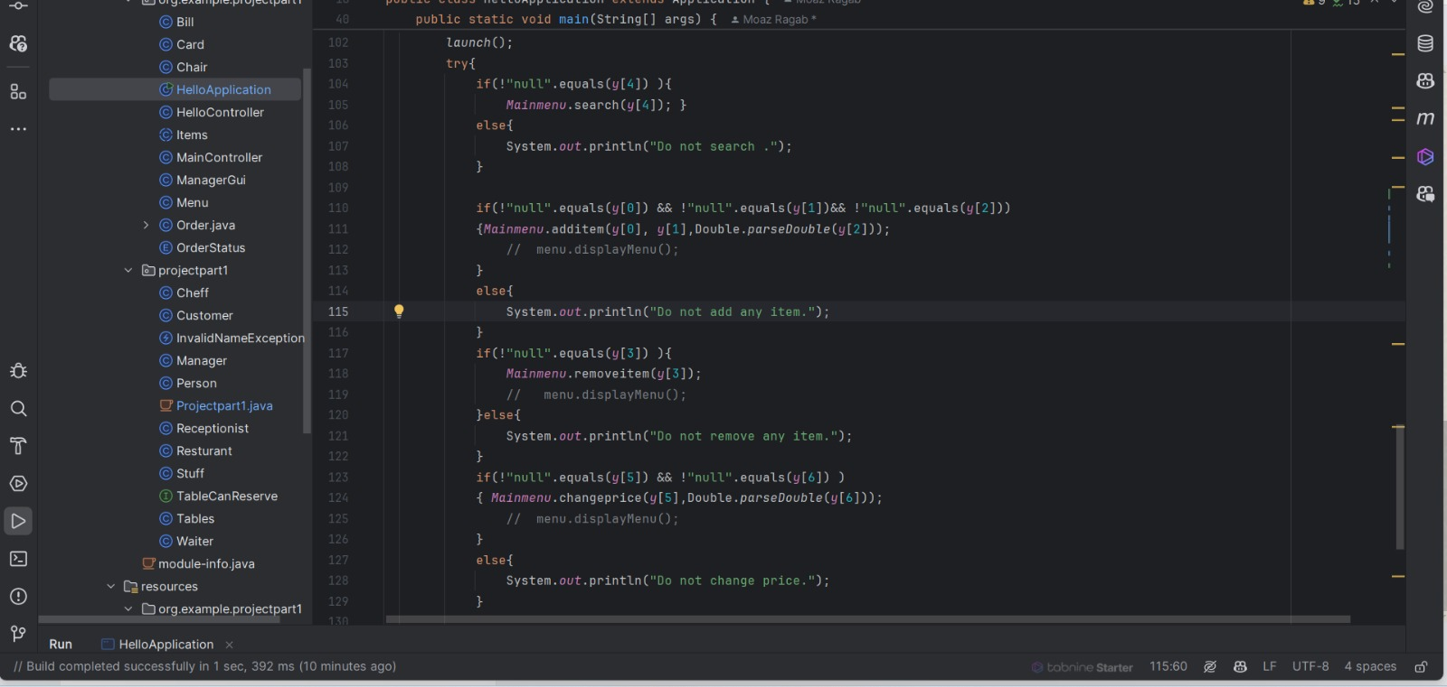
Exception handling (1)

Slide 12
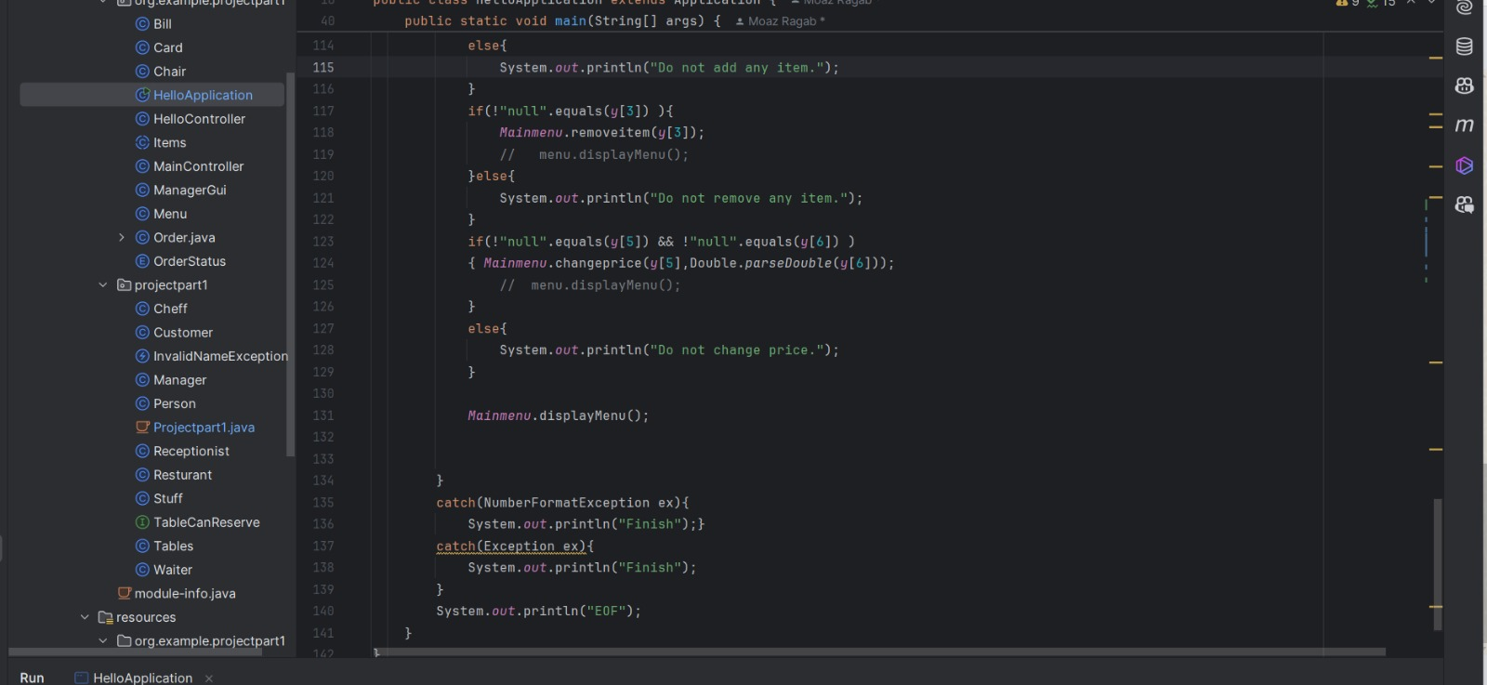

Slide 13
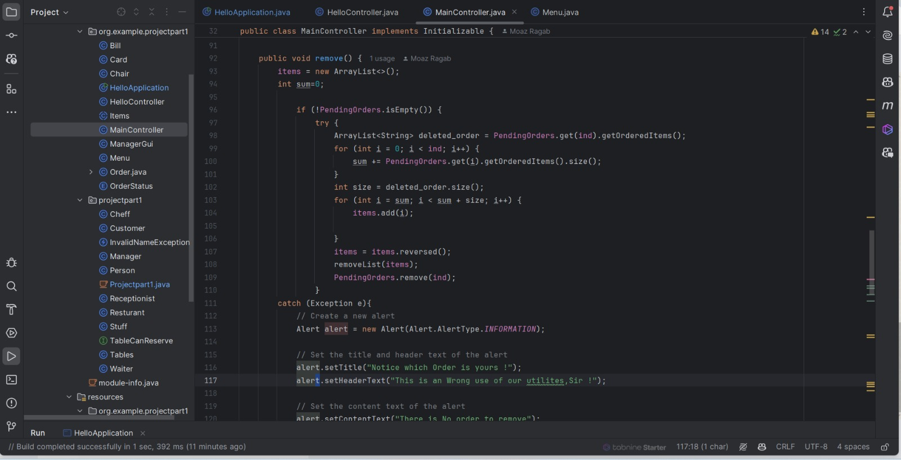
Exception handling (2)

Slide 14
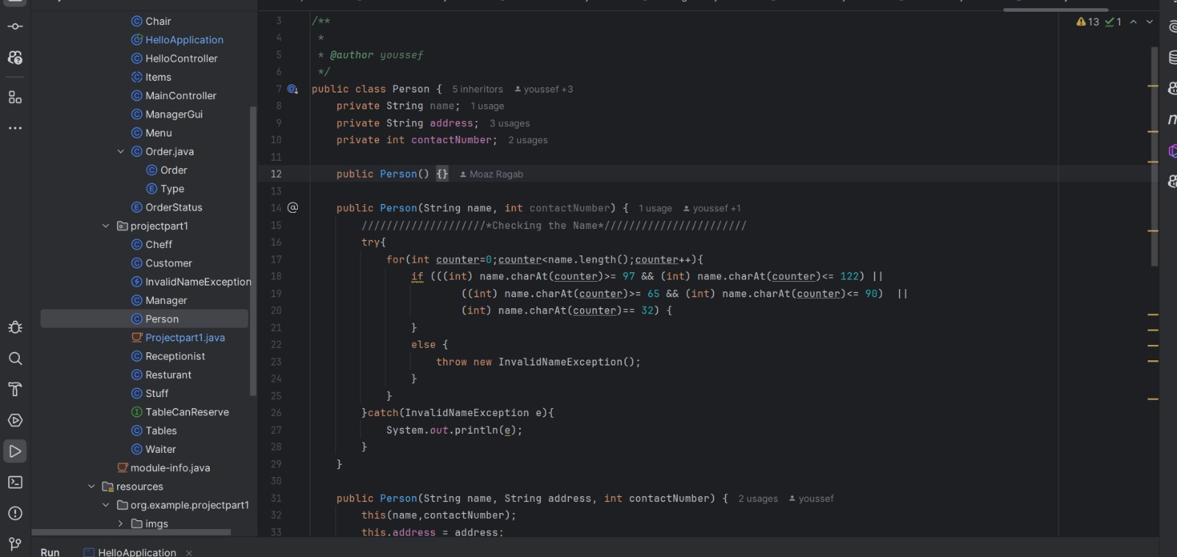
Exception handling (3)

Slide 15
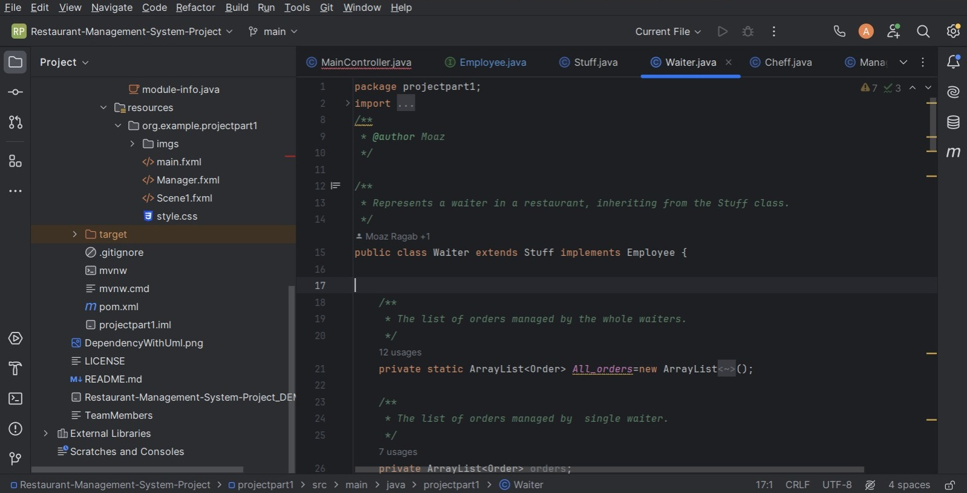
polymorphism

Slide 16
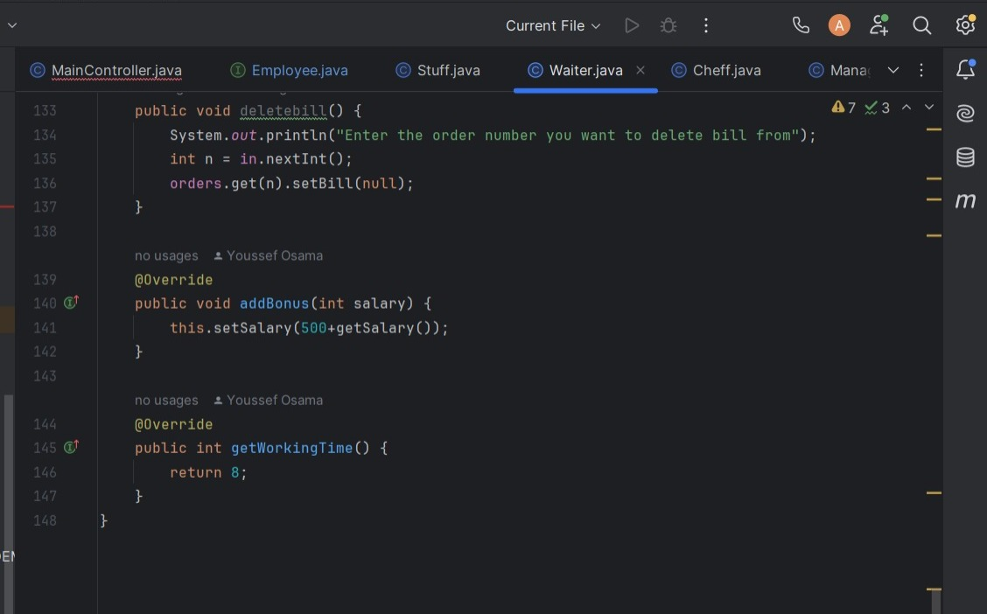

Slide 17
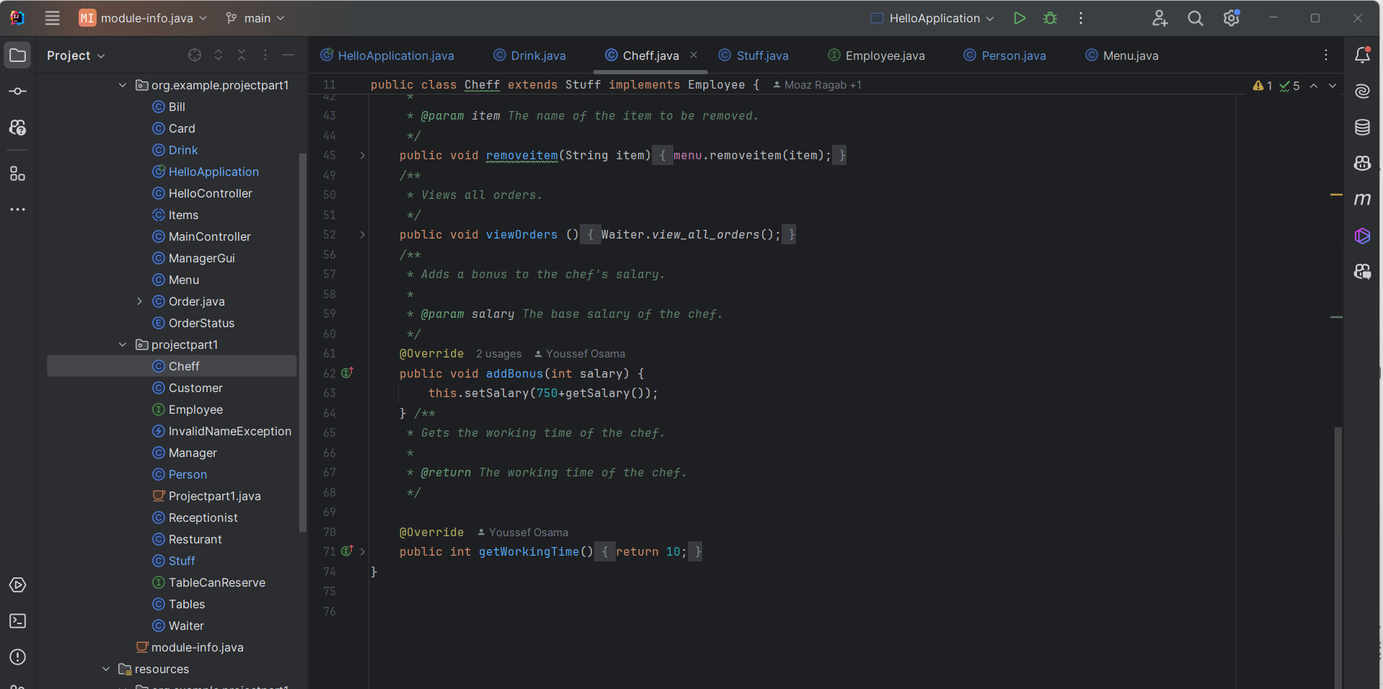

Slide 18
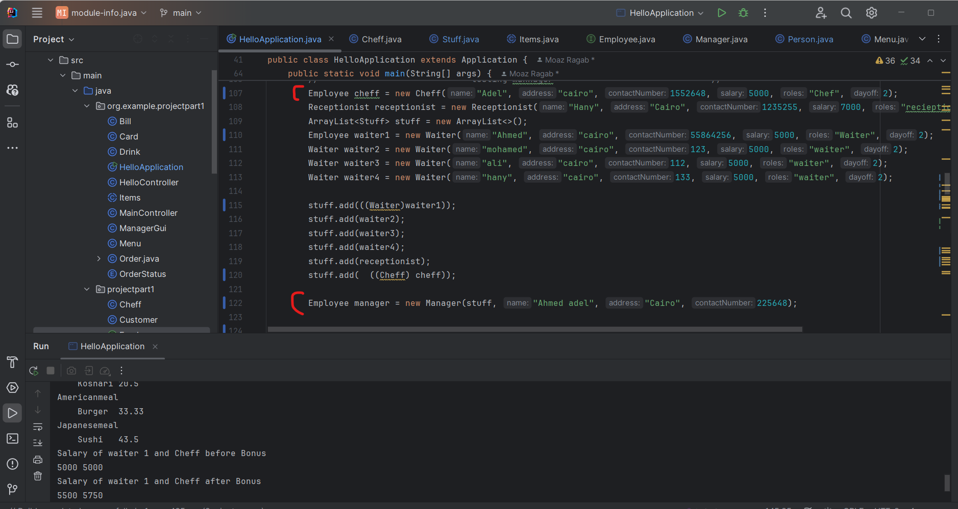
polymorphism

Slide 19
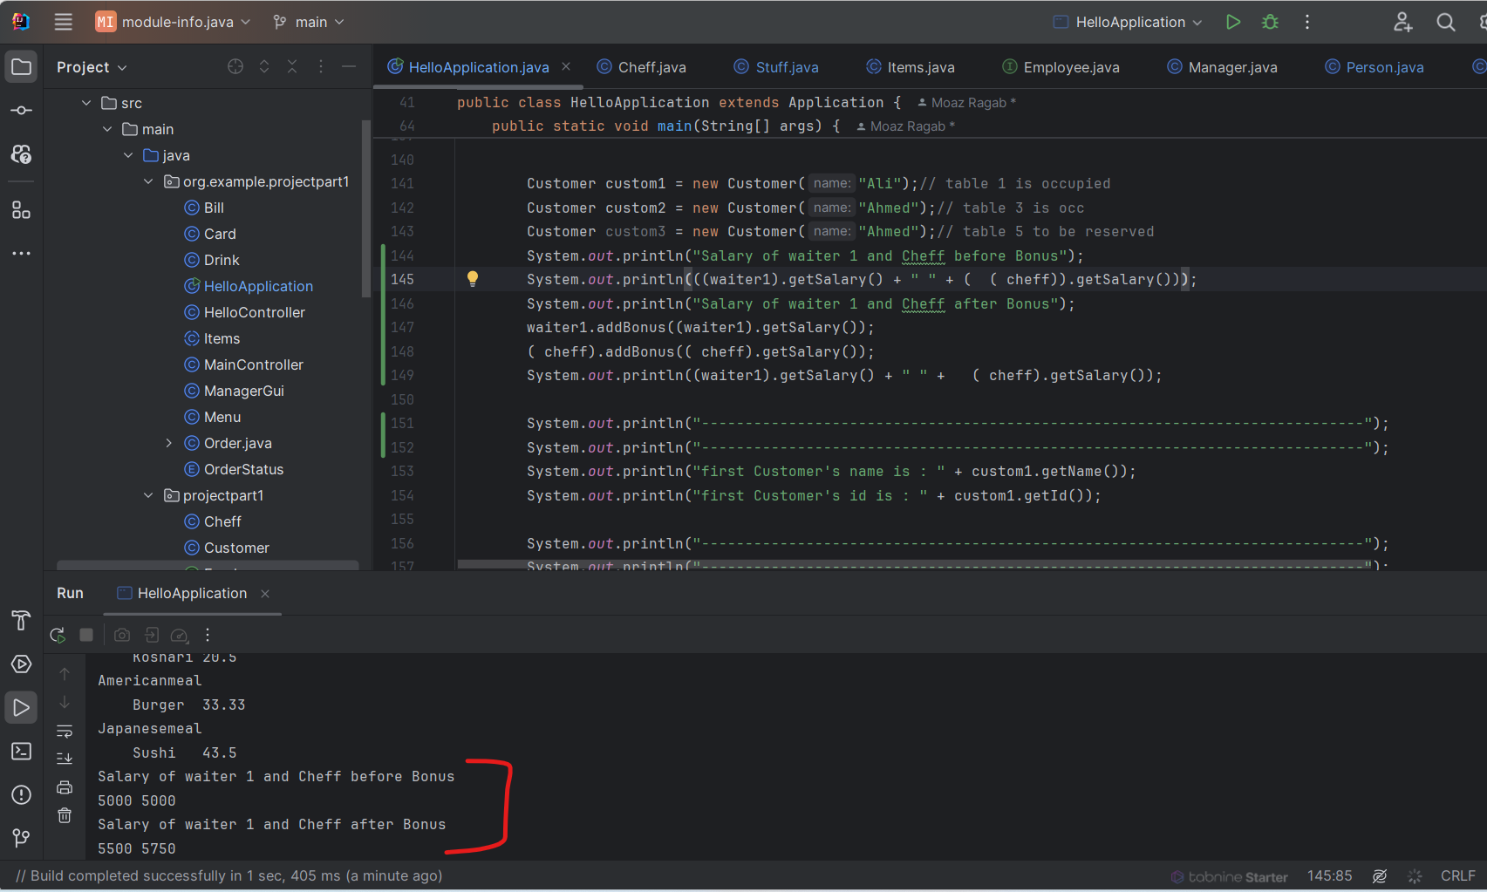
polymorphism

Slide 20
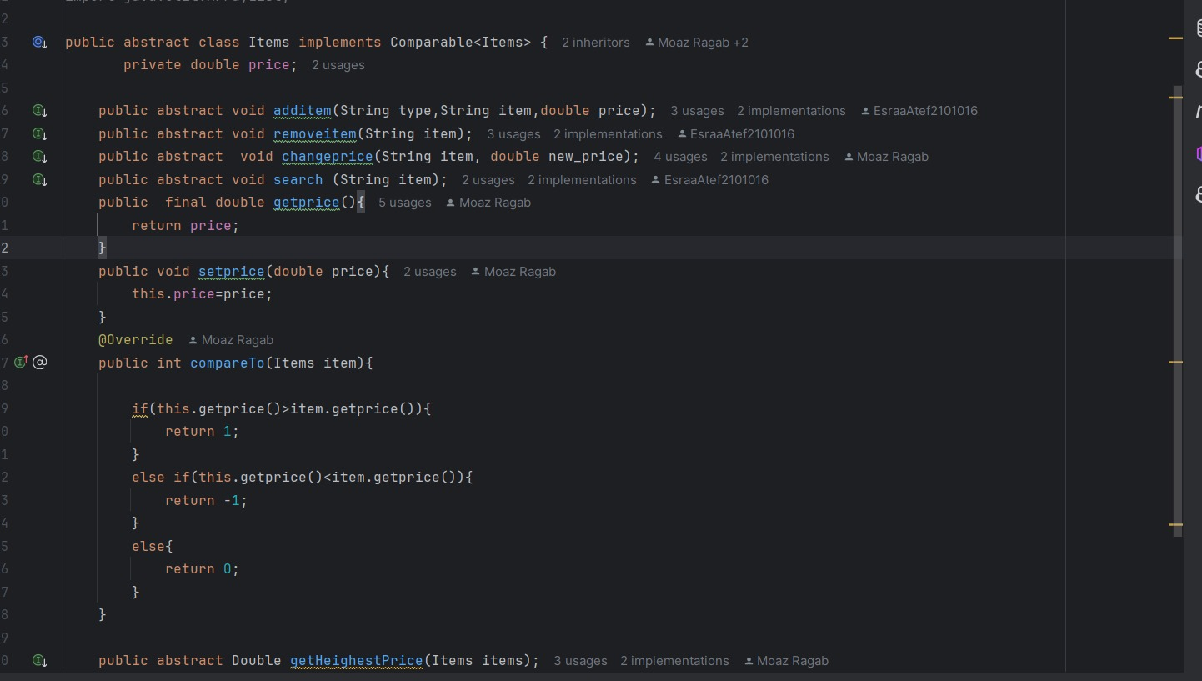
The bold objects in your implementation should be sorted using the generic sort method

Slide 21
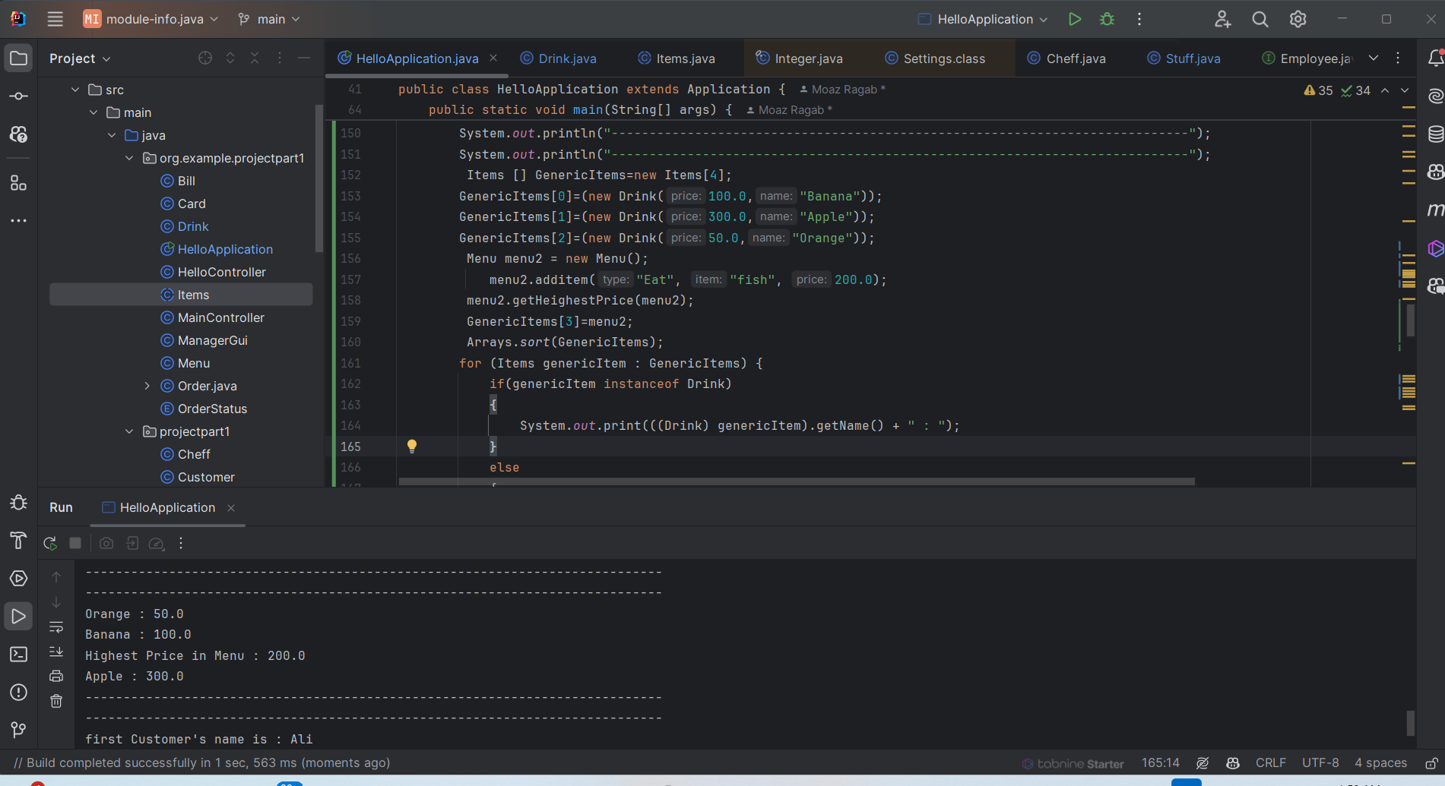
Generic Sort

Slide 22
GUI

Slide 23
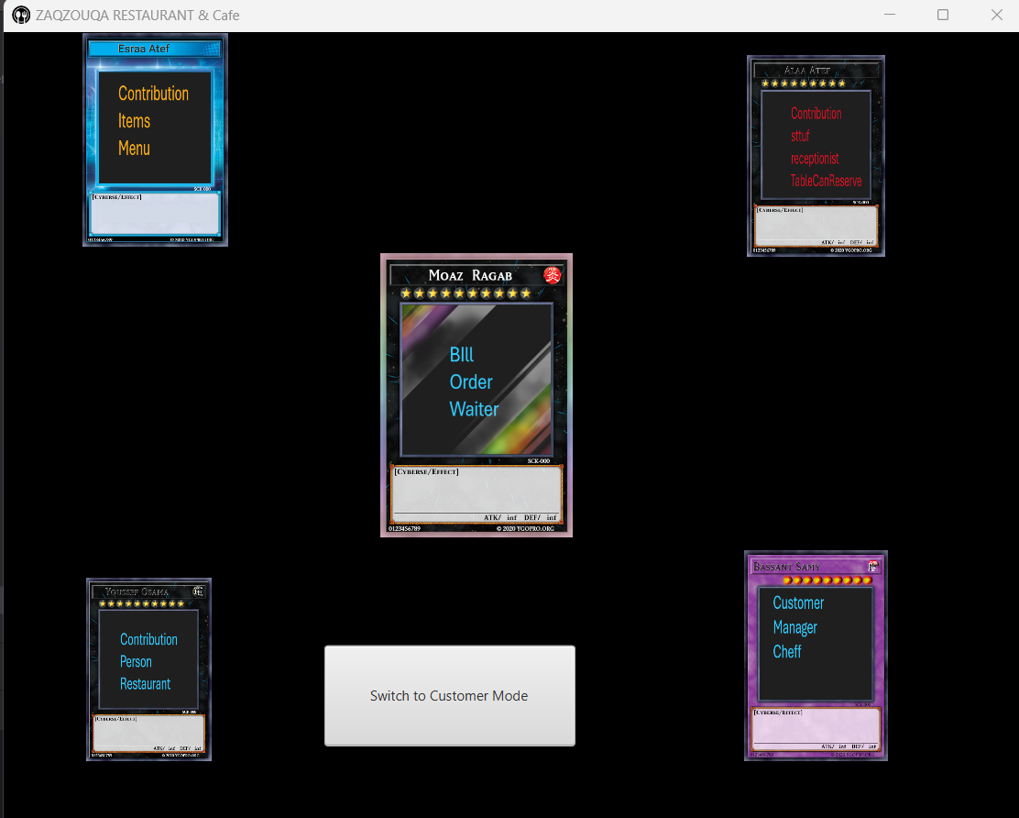
In two or three columns

Slide 24
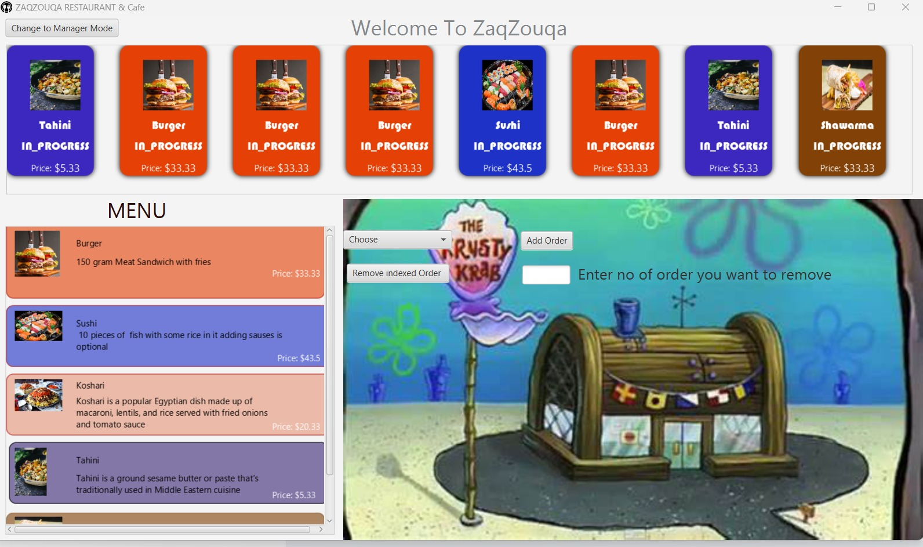

Slide 25
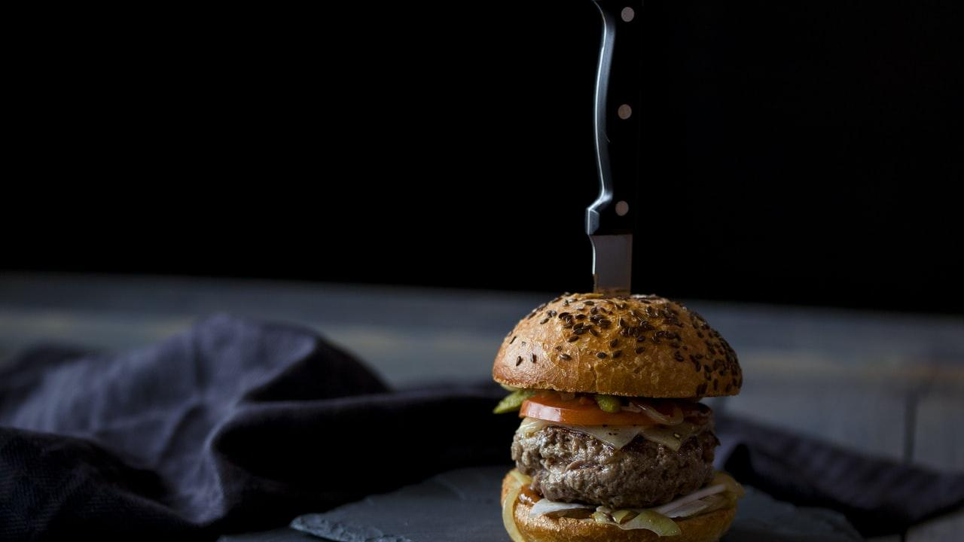
Menu
Add item
Remove item
Search in menu
Change price
Sort menu
Display menu

Slide 26
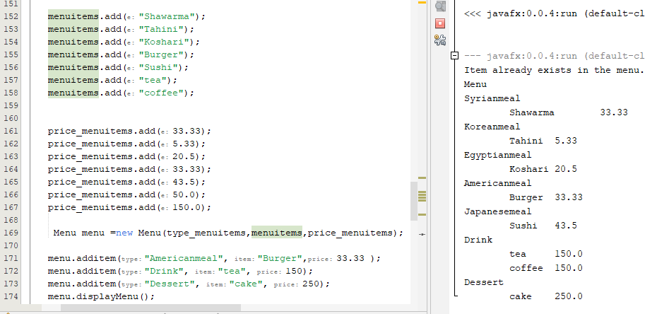
Test function add item

Slide 27
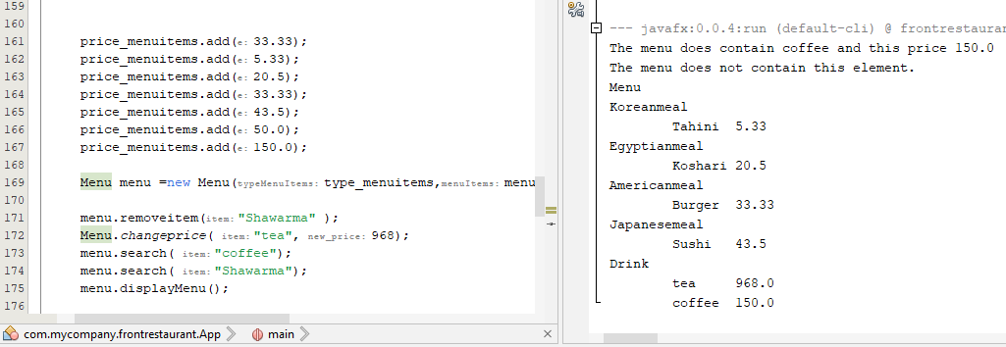
Test function remove item, search and change price

Slide 28
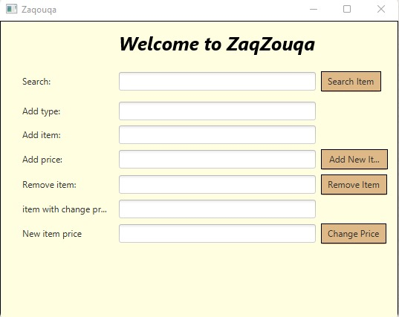

Slide 29
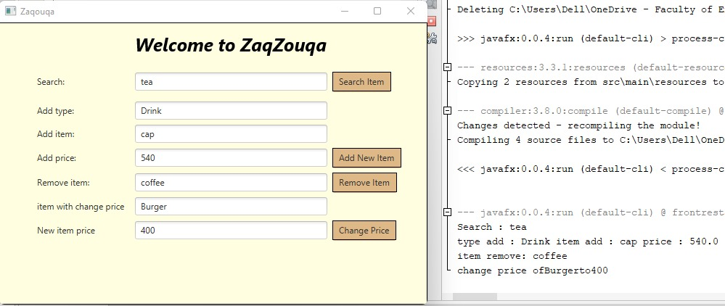

Slide 30
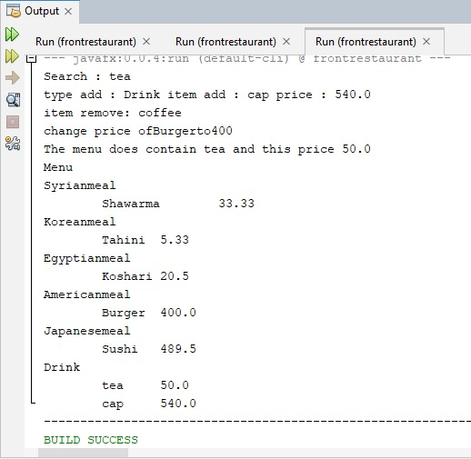
Output

Slide 31
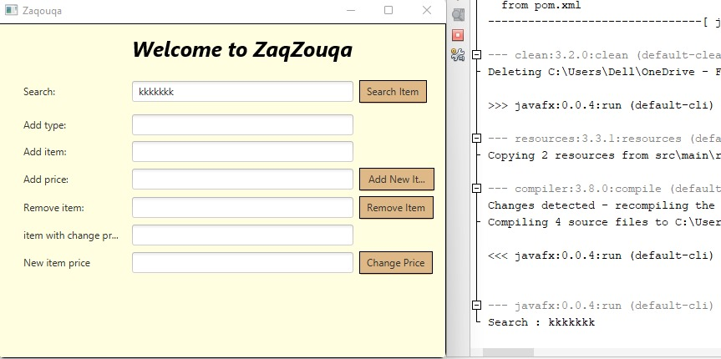

Slide 32
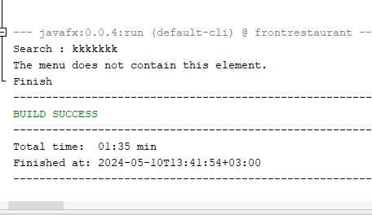
Output

Slide 33
Extra
Resources

Slide 34
Link
Git_Hub_Repo

Slide 35
Thanks

